Slide 1
Mantid Current Development and other news
Nicholas Draper
Scientific Steering Committee 2016

Slide 2
Agenda – Wednesday am
8:30 | Badging at visitor center
9:30 | Welcome & Meeting objectives (Toby Perring) Scientific direction & drivers from ORNL (Garrett Granroth) Scientific direction & drivers from ISIS (Ross Stewart) Scientific direction & drivers from ESS (Jon Taylor) Mantid plans at the ILL (Mark Johnson) Review of Progress of Mantid in 2015 (Nick Draper)
11:00 | General requirements (Nick Draper) Plotting (Owen)
12:00 | Lunch talk by Proffen

Slide 3
Agenda – Wednesday pm
13:00 | General requirements Continued (Nick Draper) VATES - multi dimensional visualization and analysis Fitting Scripting, iPython & extending Mantid LiveData Autoreduction Website / Documentation Training
15:00 | Break, then continue
17:00 | Adjourn
Wednesday Evening
No-host dinner at Aubrey's in Oak Ridge

Slide 4
Agenda – Thursday am
09:00 | Breakout group guidelines (C156)
09:30 | Science Group breakouts Diffraction (C156) Inelastic (AG07) Low-Q (AG05)
11:45 | Group Photo (meet in C156)
12:00 | Lunch - Science Publications citing Mantid - Granroth (C156)

Slide 5
Agenda – Thursday pm
13:00 | Continue in breakout rooms Groups generate priority list of medium / long term requirements
15:00 | Break (C156)
15:30 | Group presentations and discussion (C156)
16:45 | Closeout
17:00 | Adjourn

Slide 6
Releases
Complete releases since last SSC
v3.4 18th May 2015
v3.4.1 21st August 2015
v3.5 5th October 2015
V3.5.1 20th November 2015
Soon
v3.6 15th February 2016
Beta Test starts Friday

Slide 7








Supported Platforms
Supported
RHEL 6 64bit
RHEL 7 64bit
OSX Mavericks +
Windows 7 64 bit
Ubuntu 14.04 64 bit
Limited support for
Windows 8 64 bit
Fedora 20
Not officially supported, but works
Windows 10

Slide 8
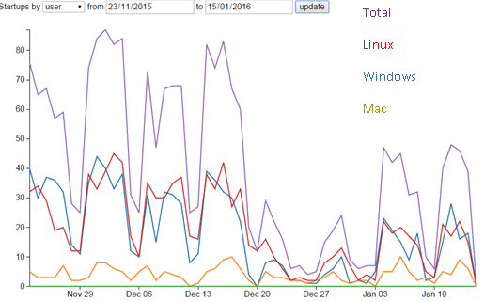
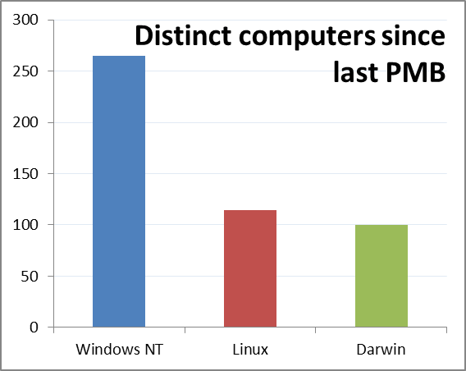
Usage
Users per day
Operating System | Unique PCs
Microsoft Windows 7 Professional | 115
Microsoft Windows 7 Enterprise | 66
Mac OS 10.10. | 48
Red Hat Enterprise Linux Workstation 7.2 | 36
Mac OS 10.11. | 35
Red Hat Enterprise Linux Server release 6.6 | 33
Microsoft Windows 8.1 | 17
Microsoft Windows 10 Home | 16
Microsoft Windows 7 Home Premium | 16
Mac OS 10.9. | 13
Ubuntu 14.04.3 LTS | 11
Microsoft Windows 10 Pro | 9
Microsoft Windows 8.1 Pro | 9
Red Hat Enterprise Linux Workstation 7.1 | 9
Mac OS 10.1 | 7
Microsoft Windows 7 Ultimate | 4
Red Hat Enterprise Linux | 4
Red Hat Enterprise Linux Workstation release 6.5 | 4
Ubuntu 14.04.2 LTS | 3
Microsoft Windows 8.1 Single Language | 3
Scientific Linux release 6.0 (Carbon) | 2
Debian GNU/Linux 8 (jessie) | 2
Ubuntu 15.04 | 2
Ubuntu 15.10 | 2
Red Hat Enterprise Linux Workstation release 6.6 | 2
Red Hat Enterprise Linux Workstation release 6.7 | 1
Arch Linux | 1
Scientific Linux 7.1 (Nitrogen) | 1
CentOS Linux 7 (Core) | 1

Slide 9
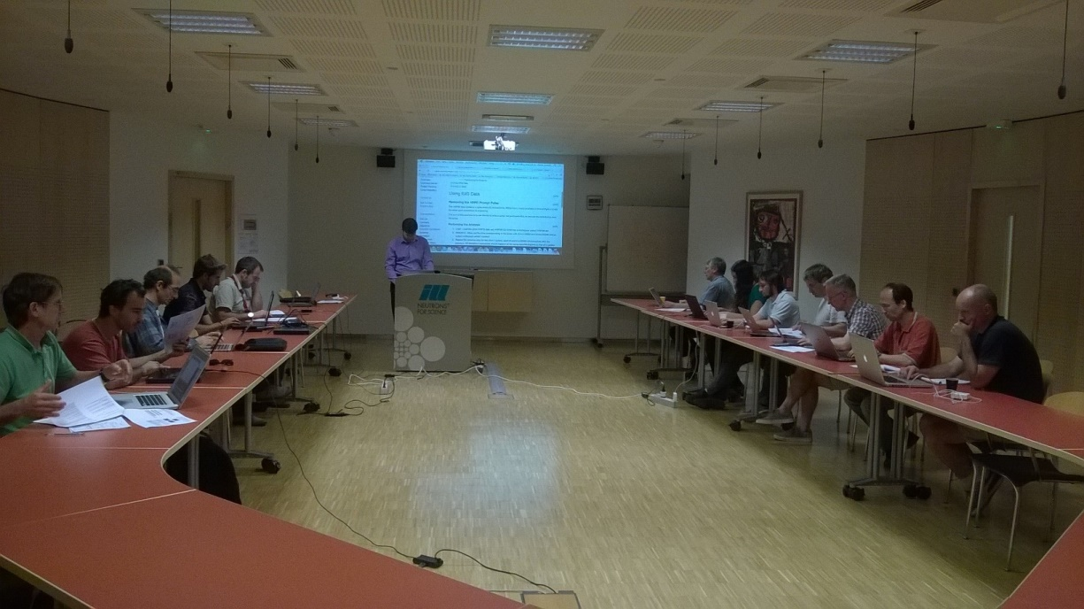
Training Courses
Dates
Last Course
September 2015
Next courses at ISIS
6-8 April 2016
ISIS Neutron Training Course
April 2016
To Book
Email: nick.draper@stfc.ac.uk
More details at www.mantidproject.org

Slide 10
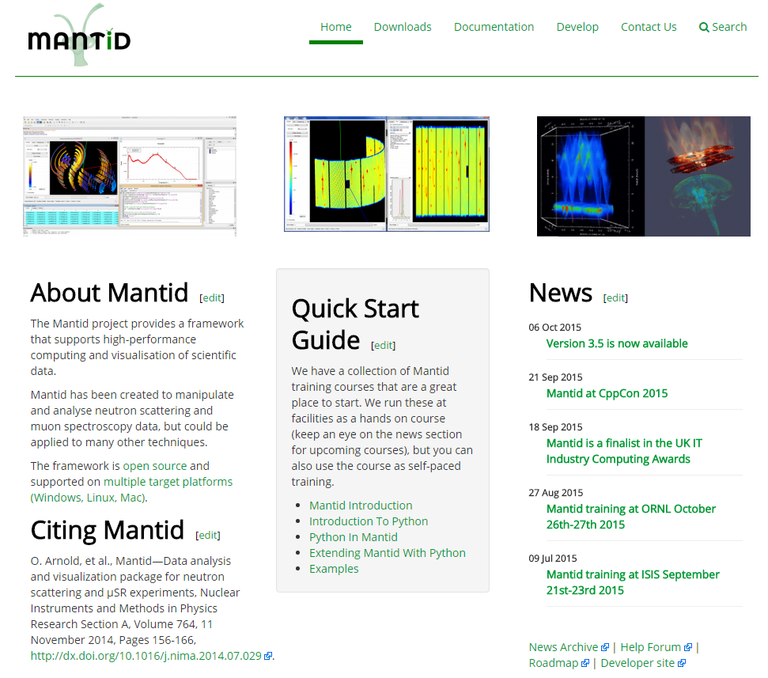
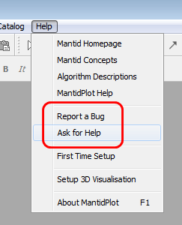
Mantid Support Forum
forum.mantidproject.org
help.mantidproject.org

Slide 11
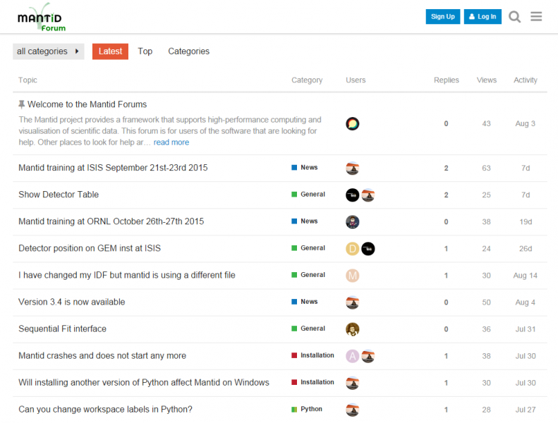
Mantid Support Forum

Slide 12
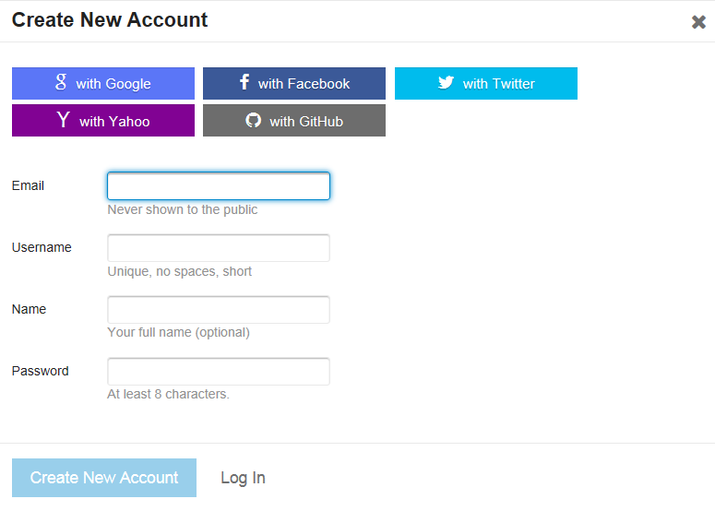
Mantid Support Forum

Slide 13
User Interface

Slide 14
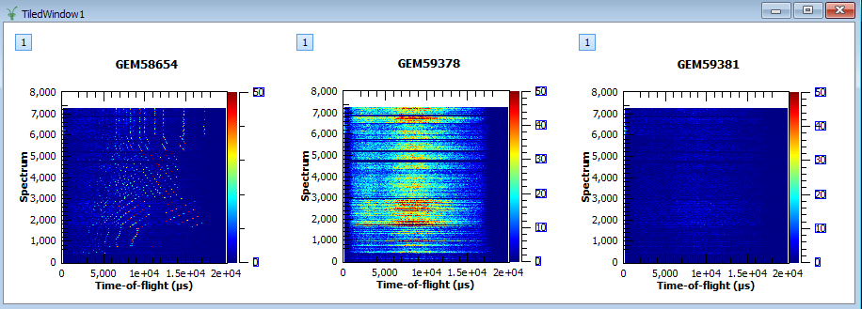
Tiled Windows

Slide 15
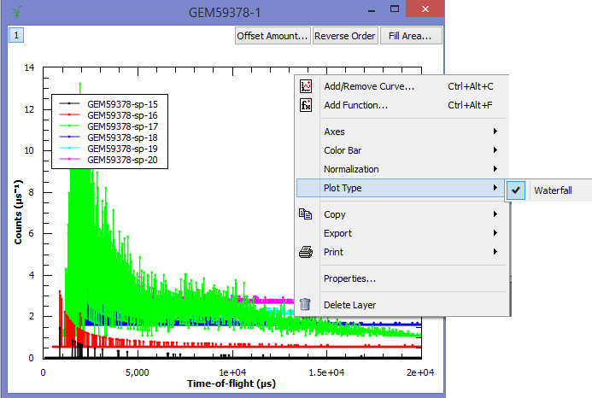
Water Fall Plots

Slide 16
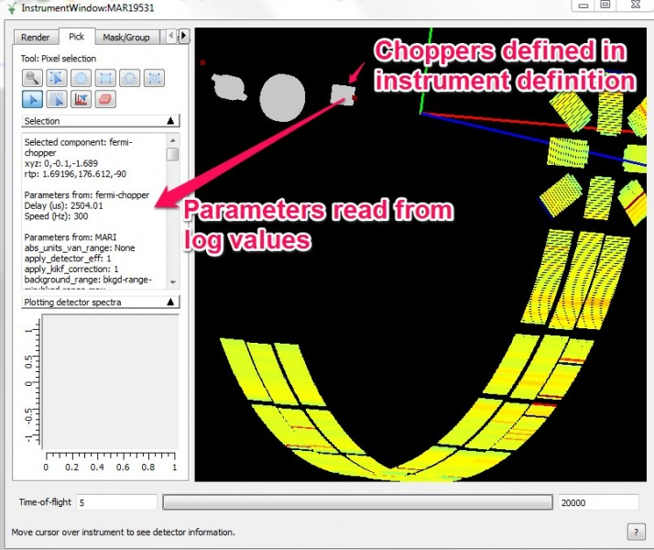
Non-detector Components

Slide 17
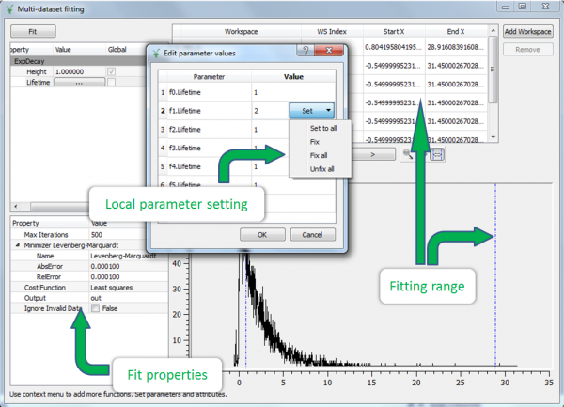
Multi-data Fitting

Slide 18
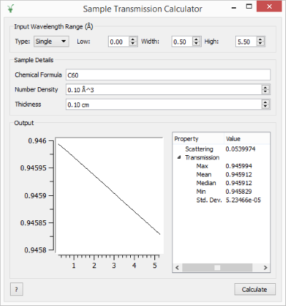
New Sample Transmission Calculator

Slide 19
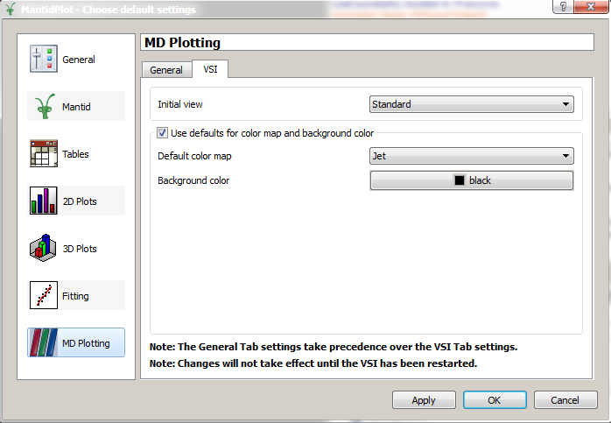
MD Viewer (VSI)

Slide 20
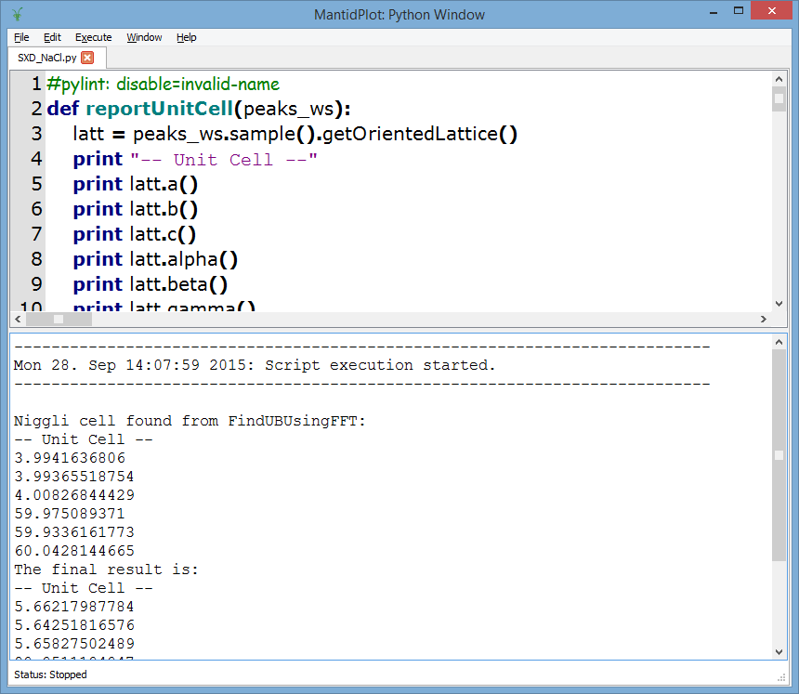
Script Window
Files that were open when MantidPlot shutdown now open automatically
You can now abort scripts!
Execute Menu → Abort
Or “Ctrl+D” shortcut
Warning – it’s a request
It can take a moments to satisfy
If an algorithm doesn’t cancel effectively → tell us
Notes:
Files that were open when MantidPlot shutdown now open automatically
Easier to close using cross icon on tab

Slide 21
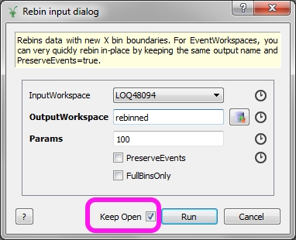
Algorithm Dialogs
Notes:
DEMO
Now simpler to run an algorithm a second time with slightly different parameters
Saves have to go and keep clicking run on the algorithms box

Slide 22
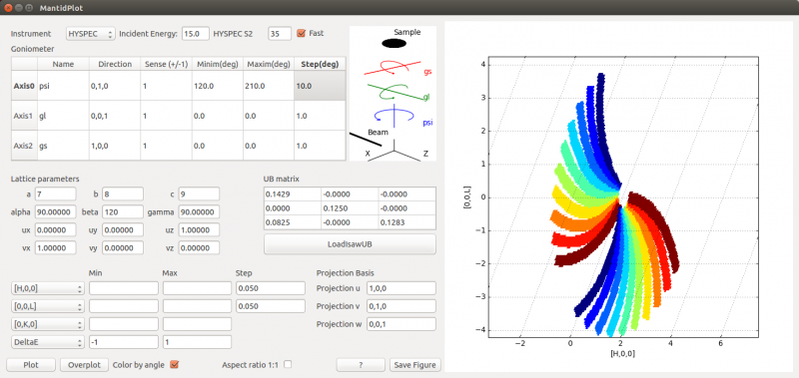
Planning Tools
DGSPlanner
Sample Transmission Calculator
Polref Slit Calculator

Slide 23
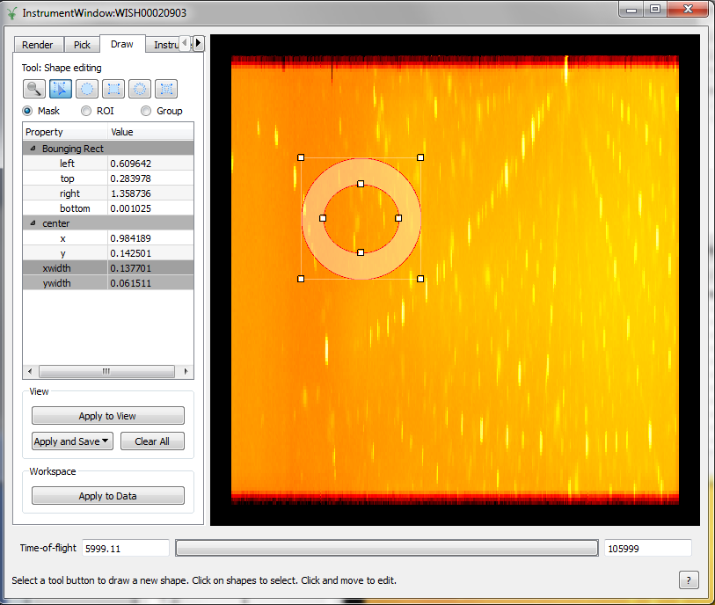
Instrument View
Notes:
Mask/Group" is now called "Draw“
New ROI mode
Technically no new functionality – just clear as to pupose of task

Slide 24
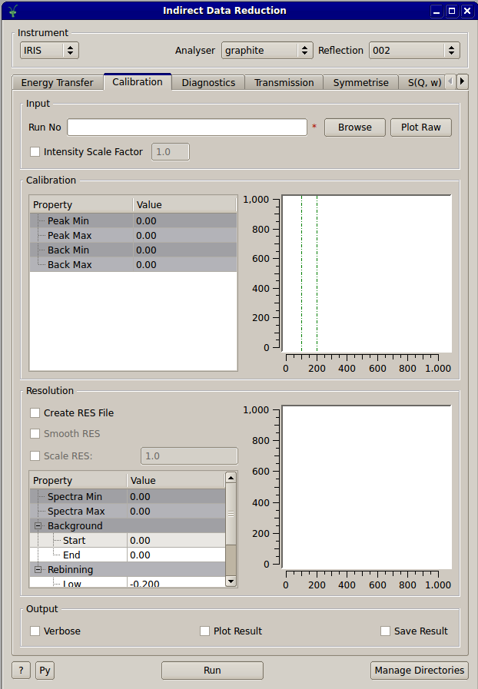
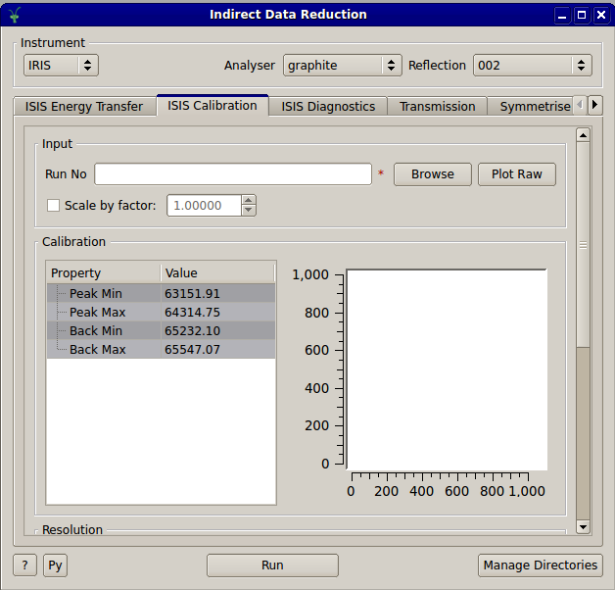
Interface Updates
Various interfaces modified to be usable on low resolution displays

Slide 25
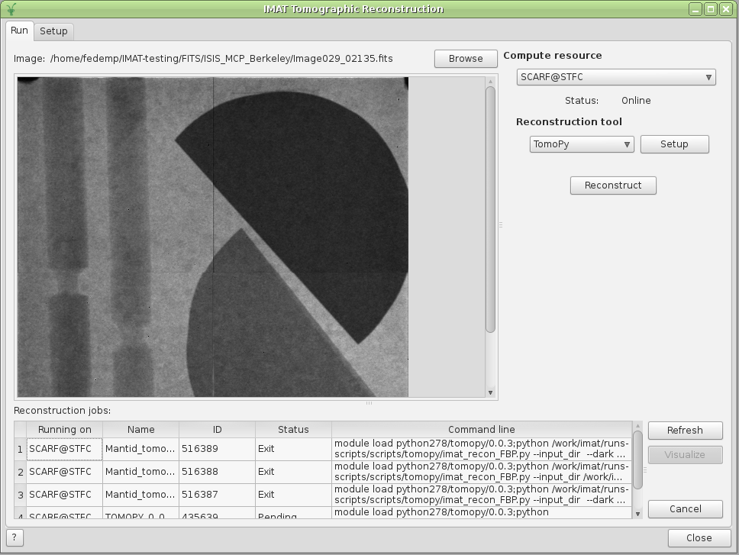
Other Important Changes
Tomographic Reconstruction User Interface

Slide 26
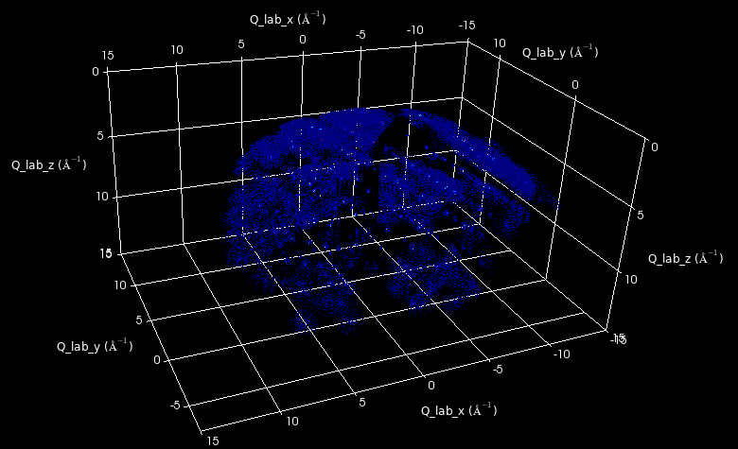
VSI

Slide 27
Framework

Slide 28

Framework – Improvements
ParaView bundled with the installation packages
Instrument definitions
You get updates automatically since v3.3

Slide 29
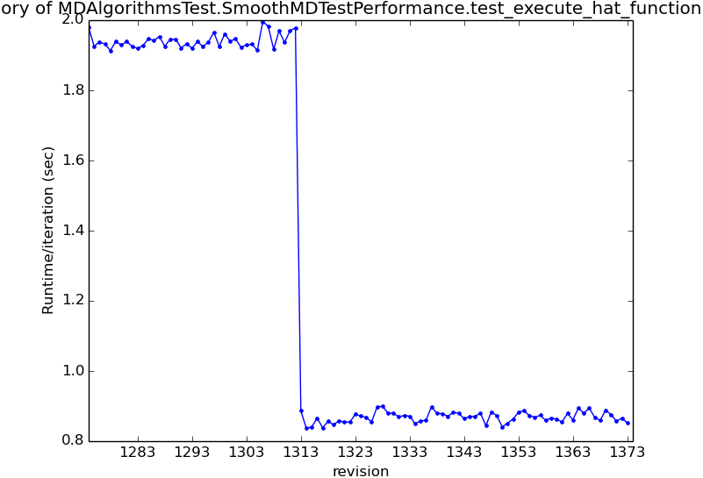
Performance Improvements
MergeMDFiles – Manages memory more efficiently, improving performance up to 30%
MergeMD – Only loads experiment information when needed, can save hours in a large MergeMD run
SaveNXSPE
Runs 2x faster
Now saves to CEPH quickly
LoadNexusProcessed
100x faster for multi-period workspaces
Project saving places multiperiod data in a single Nexus file now, which is approximately 5x faster
SmoothMD and some other multi-dimensional algorithms are running 2x faster than they were during testing
Notes:
29

Slide 30
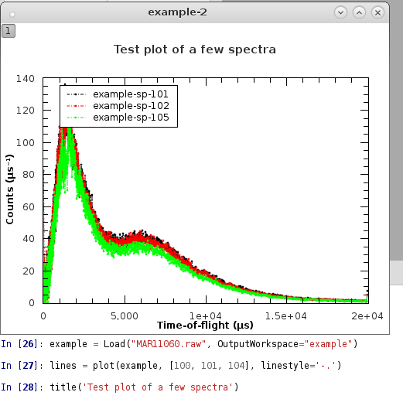
Python Plotting Command Line Interface
New Python plotting interface now available by default. Like:
Python matplotlib
Matlab plot commands
Interface:
Supports: plotSpectrum / Bin / MD
Interface:
Functional
Object-oriented
kwargs: linestyle=‘-.’, color=‘red’
VSI planned – feedback welcome
Not to be confused:
Matplotlib - also shipped
(import matplotlib)

Slide 31
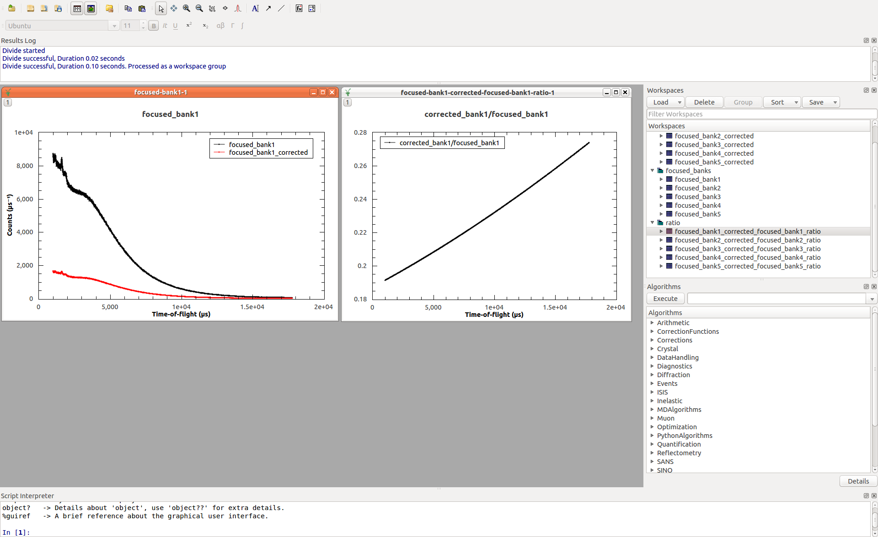
Multiple Scattering
New algorithm for corrections due to absorption and multiple scattering - MayersSampleCorrection
Based on J. Mayers OpenGenie correct routine
Cylindrical sample, elastic scattering
Multiple scattering requires isotropic scatterer
Multiple scattering correction is optional
http://docs.mantidproject.org/nightly/algorithms/MayersSampleCorrection-v1.html
Needs more widespread testing!
Notes:
See documentation for more detail, reference link and usage example

Slide 32
Reflectometry

Slide 33
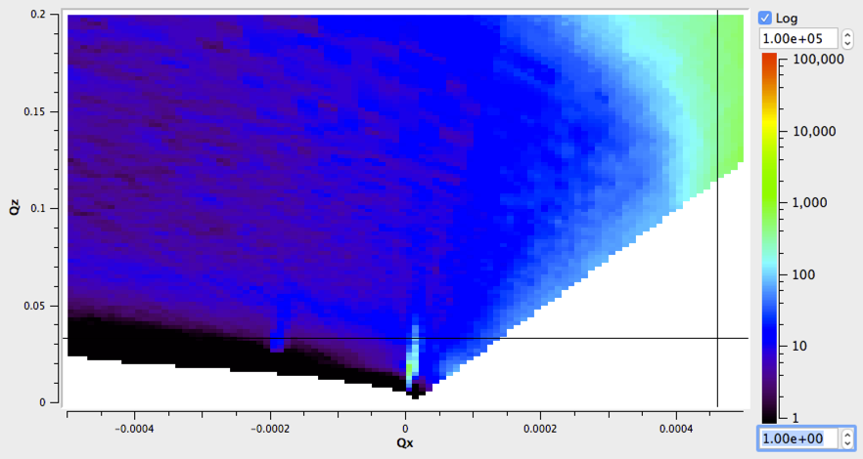
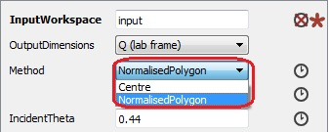
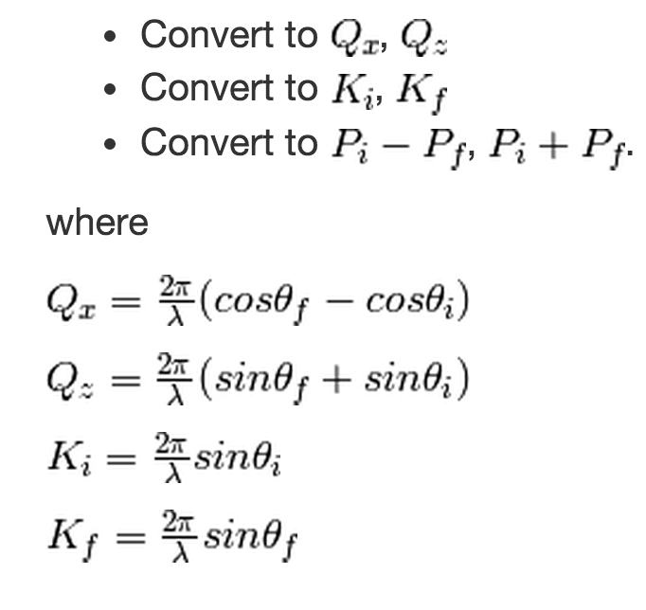
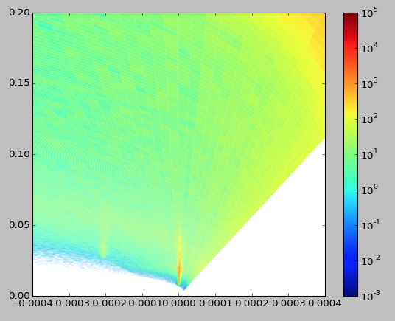
ConvertToReflectometryQ (SofQW)

Slide 34
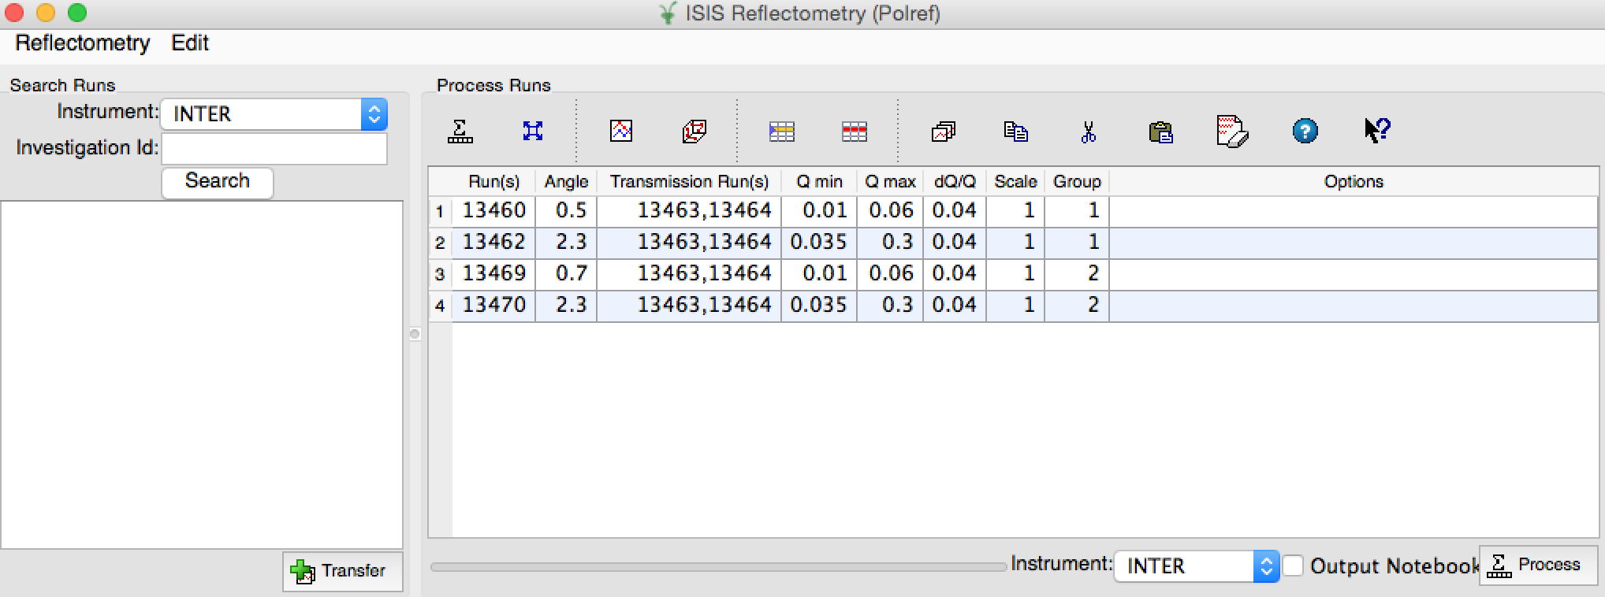
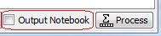
Electronic Notebooks

Slide 35
Indirect Inelastic

Slide 36
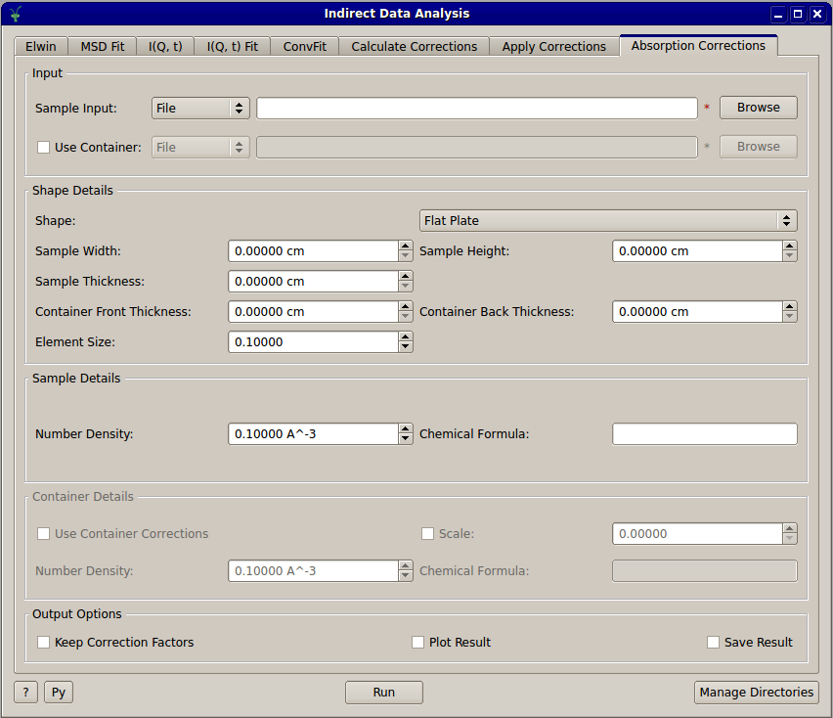
Indirect Data Analysis
Cross platform absorption correction algorithms integrated into the UI
Improved preview plot widget in all indirect interfaces
Changing axis scales
Pan tool
Zoom tool
Automatic zooming
Legend toggle
Added offline documentation for all indirect user interfaces
Support for Quasi elastic fit functions
Bayesian Analysis
FABADA in ConvFit and I(Q, t) Fit
Notes:
36

Slide 37
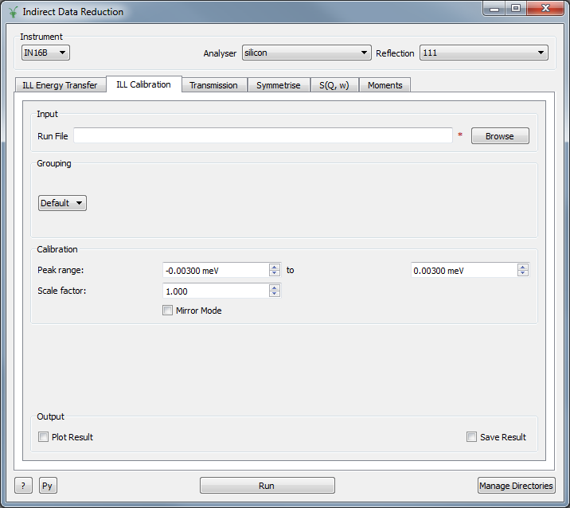
IDR Multiple Facility Support
Added support for IN16B reduction on Indirect Data Reduction
Allow entire UI to be customised per facility
Facility Support for the ILL
ILL Calibration tab
IN16B

Slide 38
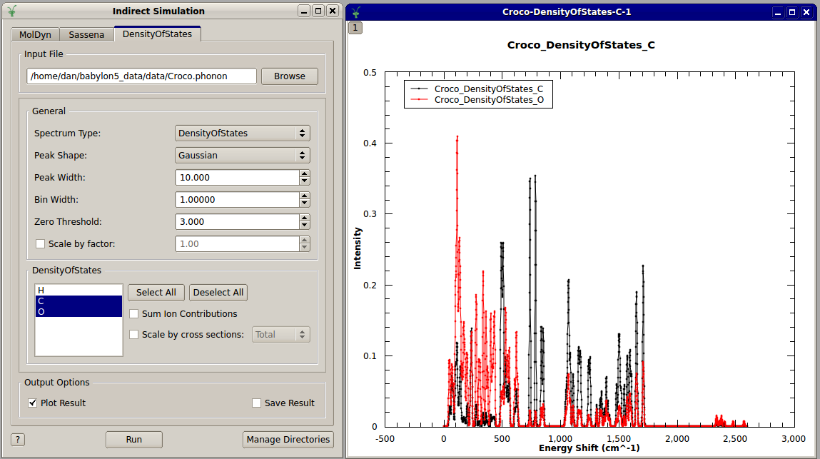
Indirect Simulation
Support for nMOLDYN 4
Added DensityOfStates tab to Indirect Simulation interface
Allows easier selection of a partial DOS from CASTEP output
DOS spectra output for TOSCA comparison

Slide 39
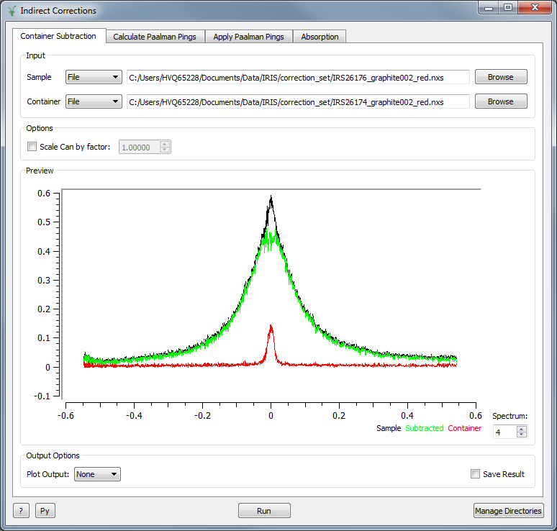
Indirect Corrections
New interface
Interfaces > Indirect > Corrections
Container Subtraction
Simple interface that only subtracts the container

Slide 40
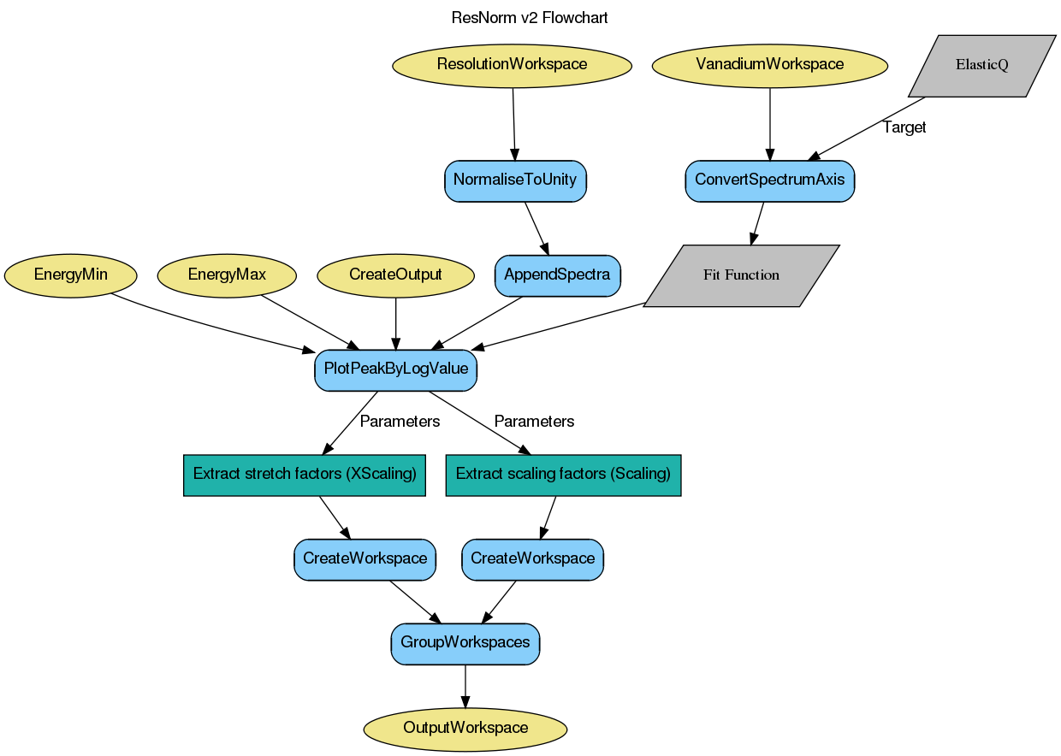
Documentation
Workflow diagrams

Slide 41
SANS

Slide 42
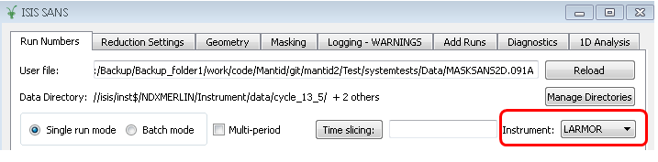
SANS
ISIS SANS GUI
Support for LARMOR

Slide 43
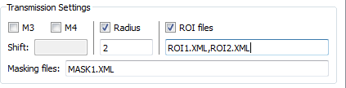
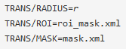
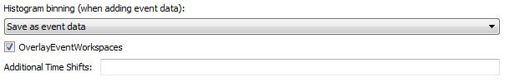
Extended Transmission Settings (Reduction Settings Tab)
User File Commands:
Overlay added event workspaces (Add Runs Tab)

Slide 44
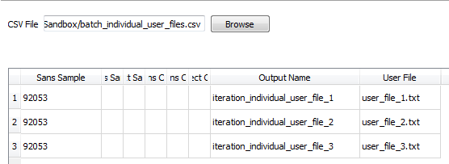
Support for loading multi-period event data
Individual User Files in Batch mode

Slide 45
Muon

Slide 46
Algorithms & Functions
RRFMuon (New)
Calculates Muon Assymetry in a rotating reference frame
DynamicKuboToyabe fitting function (New)
LoadMuonNexus
Correct labelling of specified spectra (Min/Max/List)
DeadTimeTable and DetectorGroupingTable containing
specified spectra only
PlotAsymmetryByLogValue
Missing run numbers are allowed
Functions of LogValue: Mean, Min, Max, First, Last

Slide 47
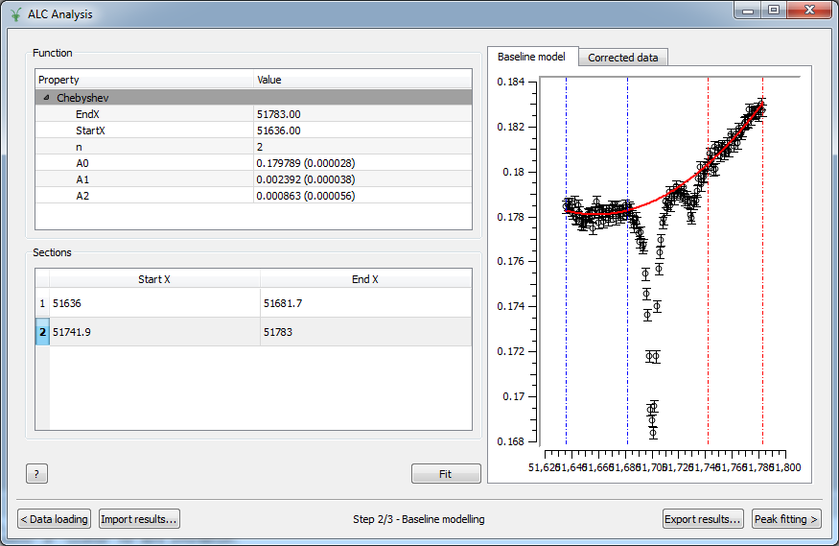
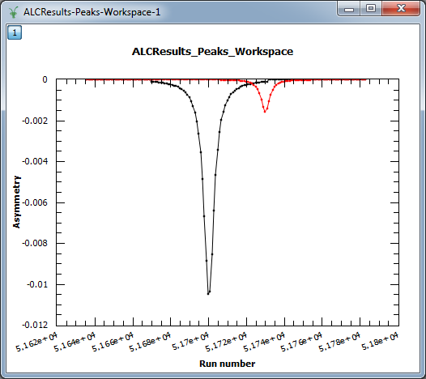
ALC Interface
Export and Import results
Parameter errors
BaselineModelling: range selectors
Error bars
Peaks exported as separate spectra

Slide 48
Direct Inelastic

Slide 49
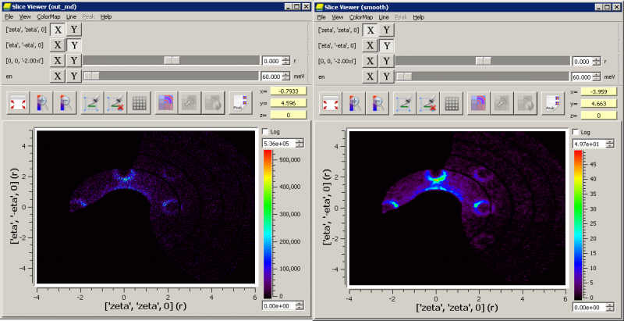
Horace Style Commands
CutMD equivalent to cut_sqw
Introduction of Horace style Projections into Mantid
CreateMD equivalent to gen_sqw
Creates merged workspaces in one step
With a file-backed mode
SmoothMD equivalent to smooth
IntegrateMDHistoWorkspace

Slide 50
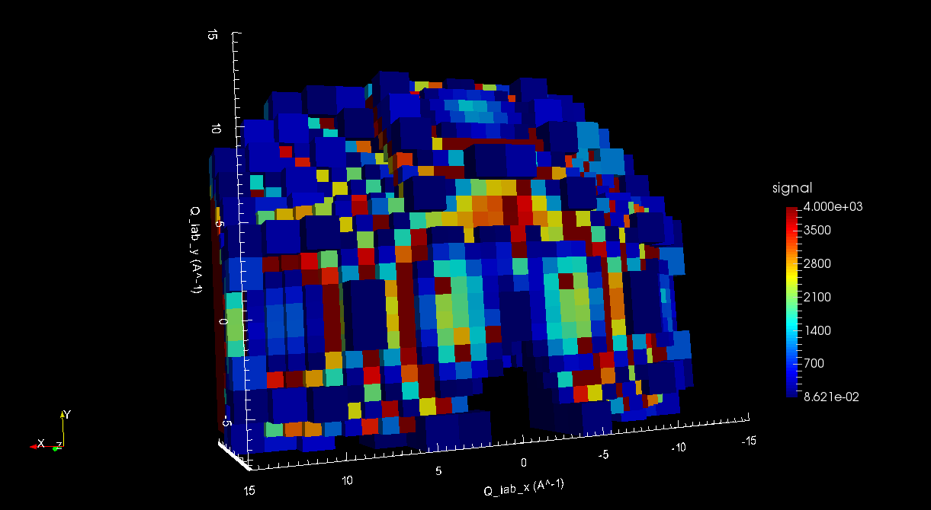
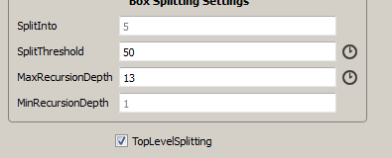
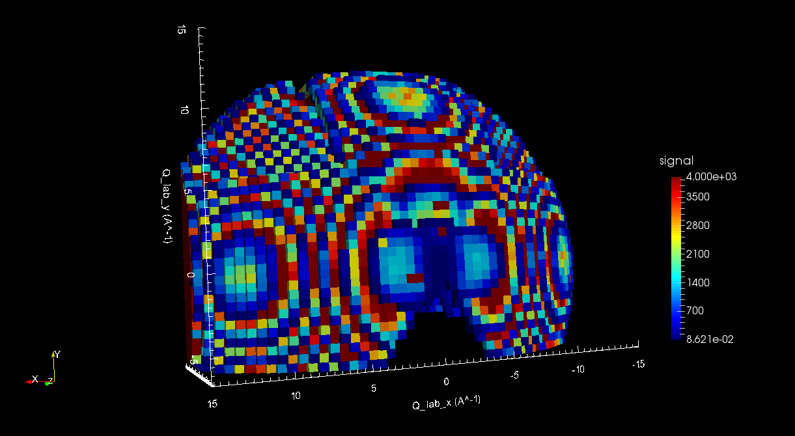
Top Level Splitting

Slide 51
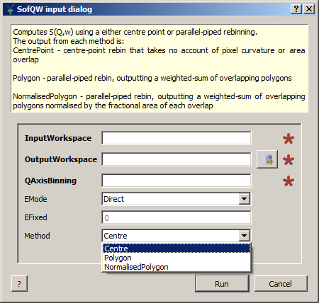
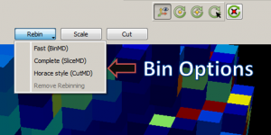
Other Important Changes
SofQW algorithms renamed. Method introduced.
Error propagation issue tracked down and fixed
Performance improvements
DGS planning tool
VSI Binning Options

Slide 52
Diffraction

Slide 53
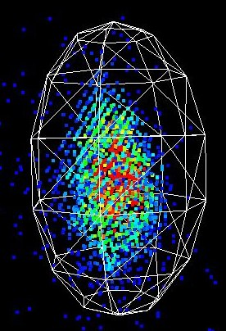
SC Peak Integration
IntegrateEllipsoids
Can now be run on 2D histogram workspaces
Account for weighted events
Now parallel processes as part of the PCA
IntegratePeaksMD
Fix to the adaptive Q radius calculation
Caches used for speed improvement
PeakShape introduced
Frame
Algorithm + Version
Flexible + extendable shape definition
Used in the 3D visualisation tools

Slide 54
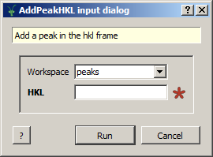
New Algorithms
StatisticsOfAPeaksWorkspace
AddPeakHKL
Horace style algorithms
CutMD,
CreateMD,
SmoothMD,
IntegrateMDHistoWorkspace

Slide 55

PeaksViewer
PeaksViewer mode of SliceViewer now supports drag-drop
PeaksViewer is now completely synchronised via MantidPlot’s PeaksWorkspaces
Up-down keyboard keys on the mini-table give zoom-to-peak feature

Slide 56

3D Visualisation

Slide 57


PeaksViewer Interactive Modes

Slide 58
Other Diffraction Improvements
“Group” has been exposed to python
Other improvements to “SpaceGroup” and “PointGroup” (see documentation)
TransposeMD and ReplicateMD added
New Engineering UI for calibration and focusing
Migration of Powder scripts to Mantid 3.5
Validation and creation of system tests

